Slide 1
UI/UX Worksheet
Project Title:
PetMatch
Team members
6530262 Min Myint Moh Soe
6530289 Sai Oum Maing
6622085 Min Htet
6520102 Aung Bhone Naing
6530198 Heang Mengtry

Slide 2
Day 11

Slide 3
Individual assignment: Create components (5%)
60 mins
Objective
To be able to use Figma application to create the components for final project.
Instructions
For each team member, use Figma to create a component with at least 2 variants that will be used in your final project.
Once finished, demonstrate to the instructor how to create them.
After that, insert picture, name of creator, annotations, short description of each component in your worksheet.
Note:
A team is required to have at least 4 components.
You can insert more slides in the worksheet (if any).

Slide 4
Individual assignment: Create components
Grading Criteria
0 = No submission
1 = Component is incomplete, or no variant is created, or can’t demonstrate how to create the component.
3 = Component and its variants are created but can’t clearly demonstrate how to create them.
5 = Component and its variants are created and can clearly demonstrate how to create them.

Slide 5
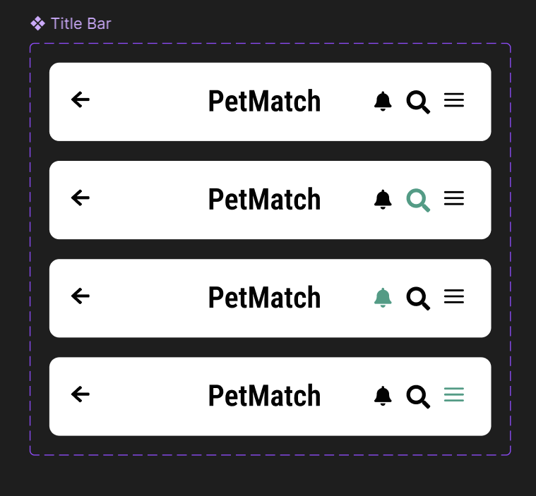
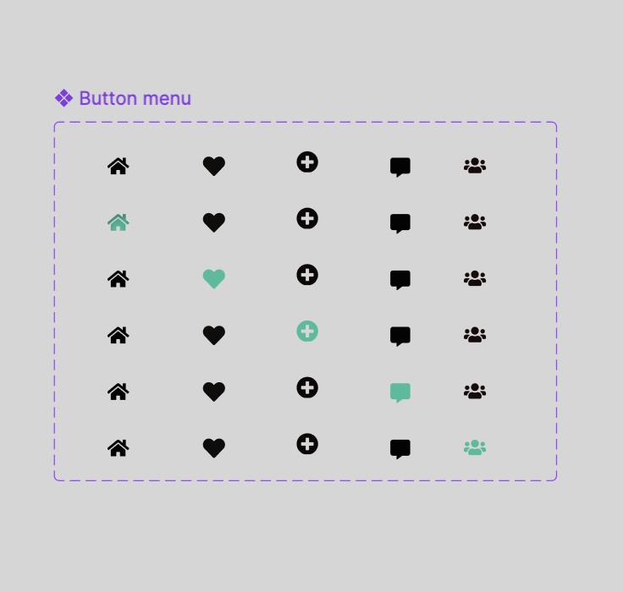
Components for final project (1)
Top Navigation Bar
(Min Myint Moh Soe – 6530262)
Footer Navigation Bar (Min Htet-6622085)

Slide 6
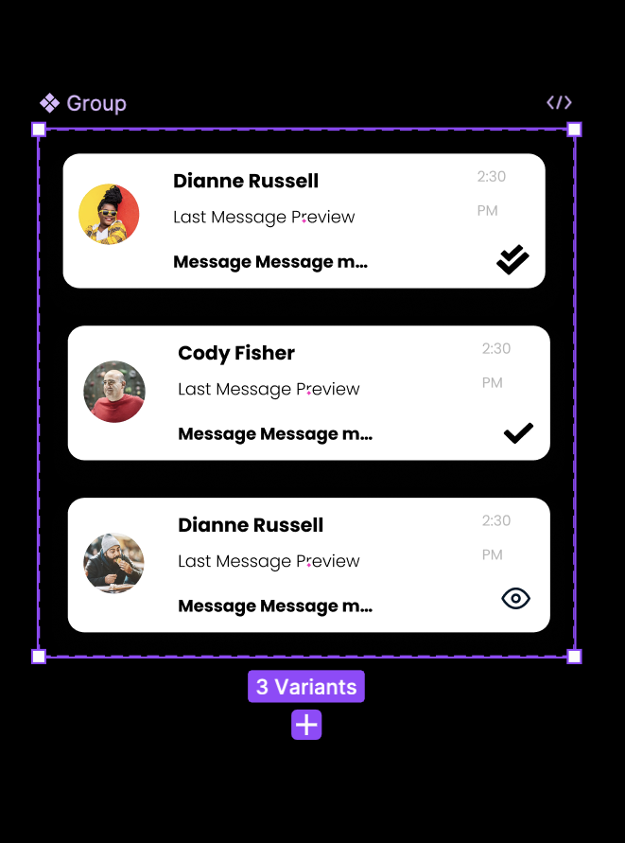
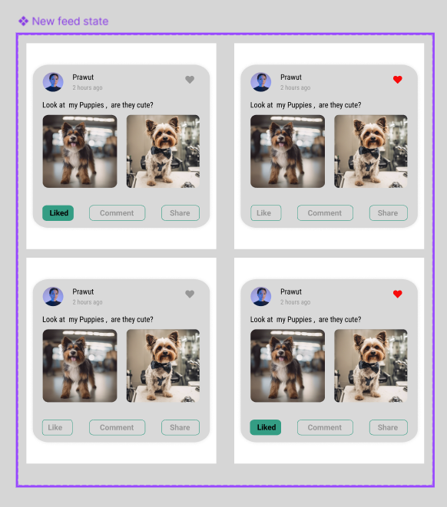
Components for final project (2)
Chat inbox
Name-Aung bhone Naing
ID- 6520102
New Feed state ( follow and like )
(Sai Oum Maing - 6530289)

